Slide 1

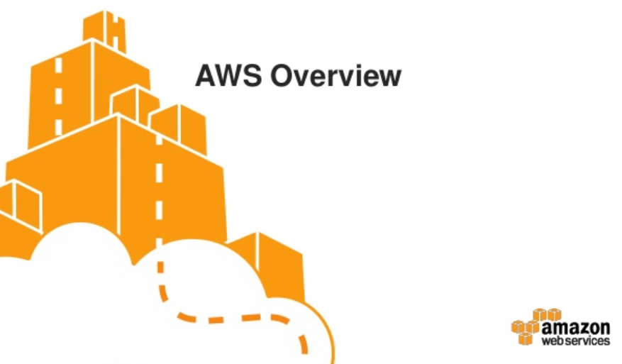

Slide 2
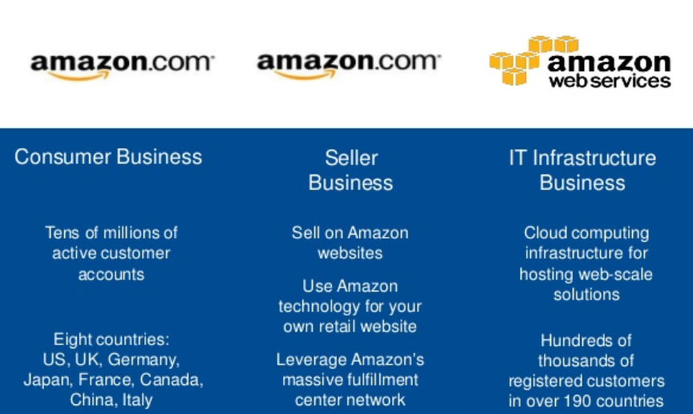

WHAT IS AMAZON??

Slide 3
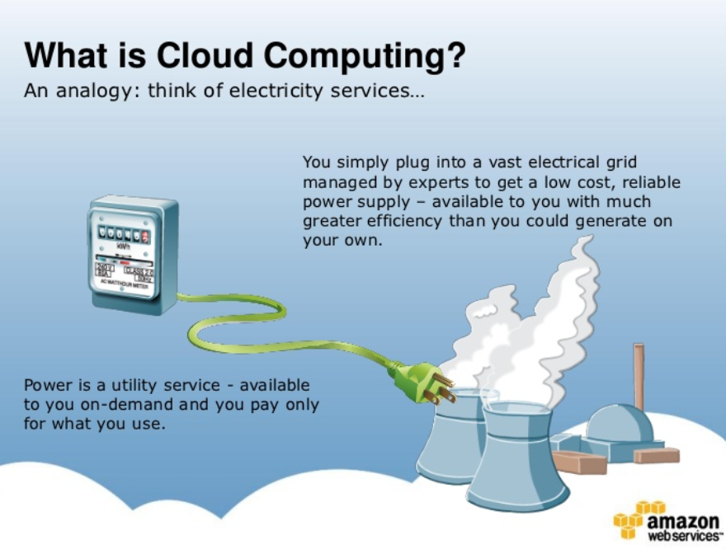
HOW GRID WORKS?

Slide 4
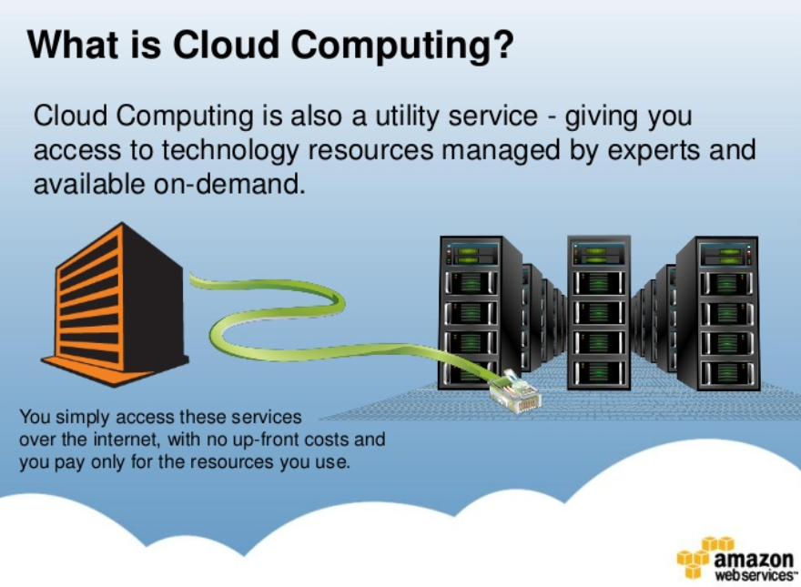
CLOUD COMPUTING

Slide 5
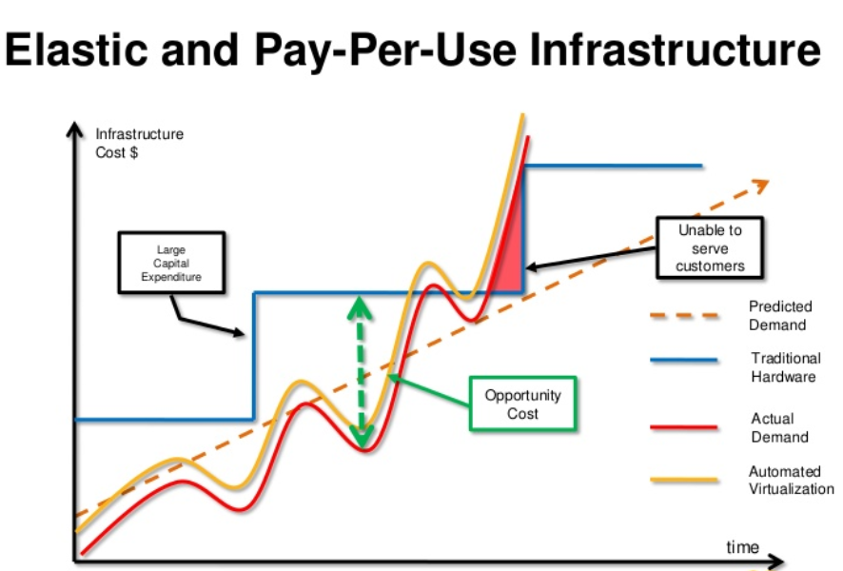
Pay as you go

Slide 6
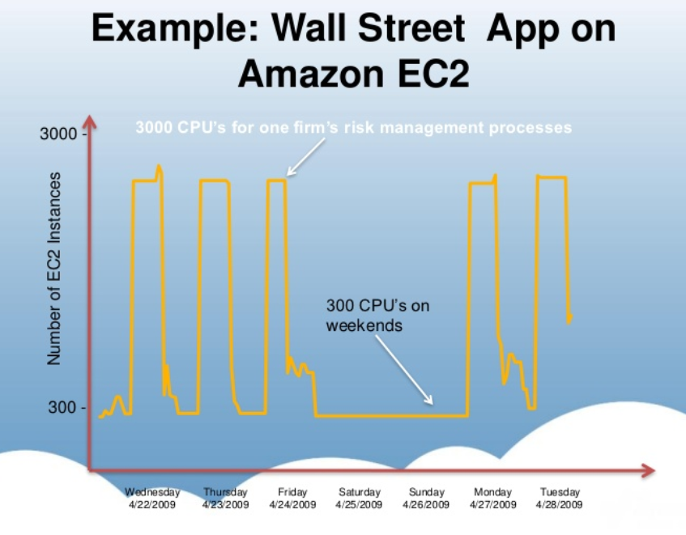
Pay as you go

Slide 7
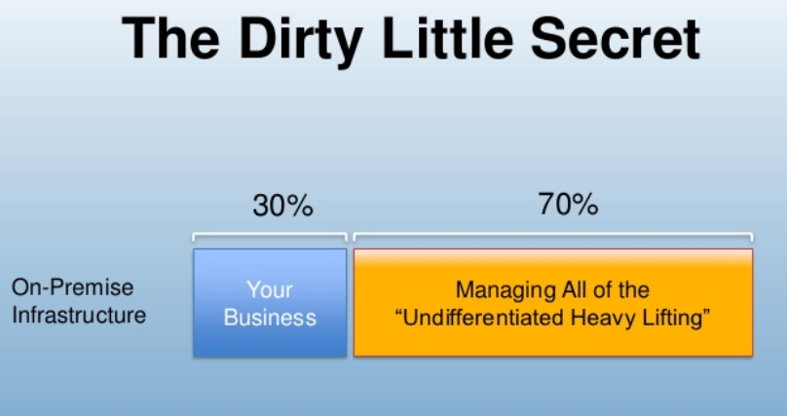
INNOVATION

Slide 8
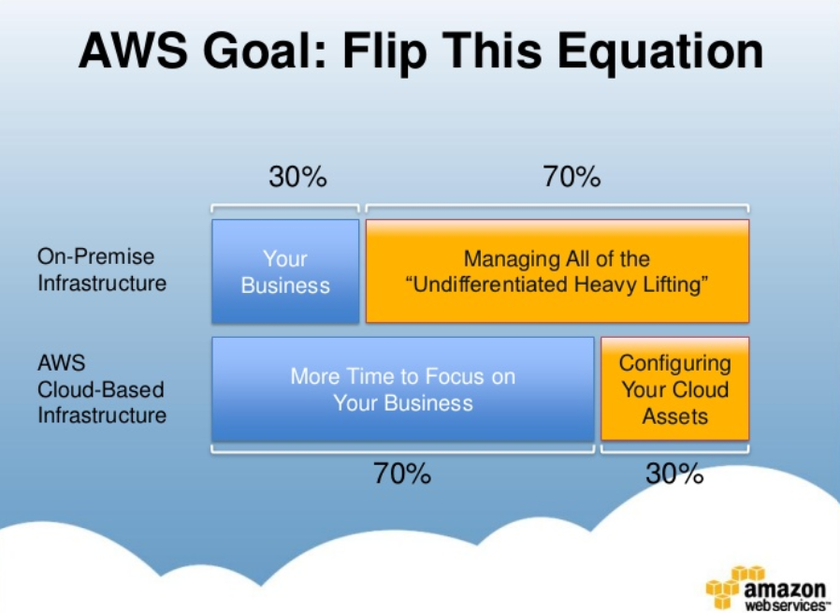
INNOVATION

Slide 9
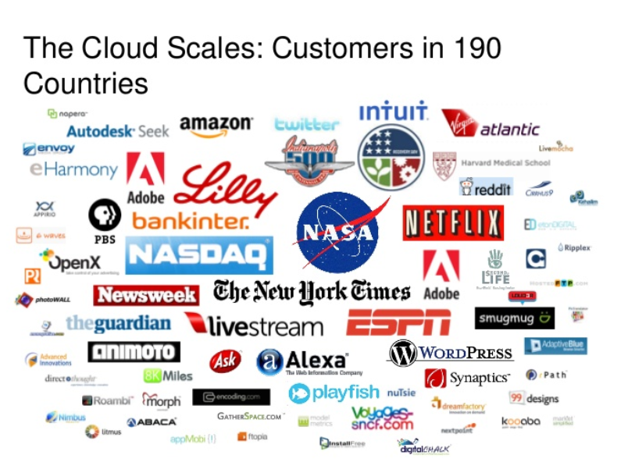
Pay as you go

Slide 10
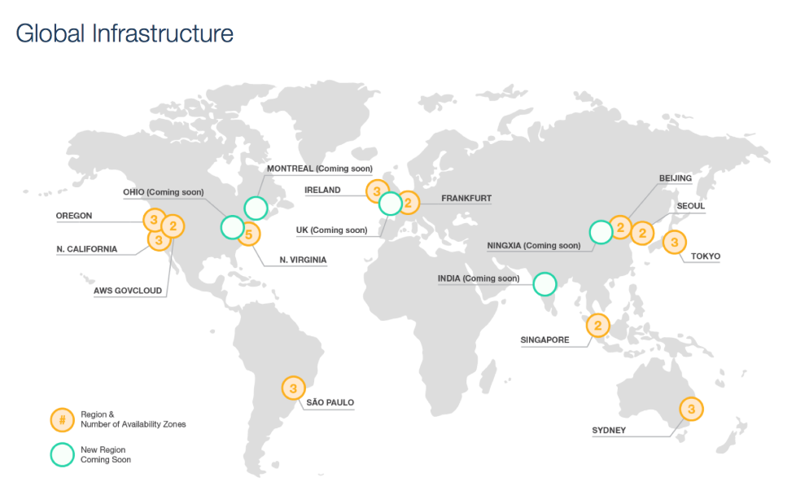
AWS REGIONS

Slide 11
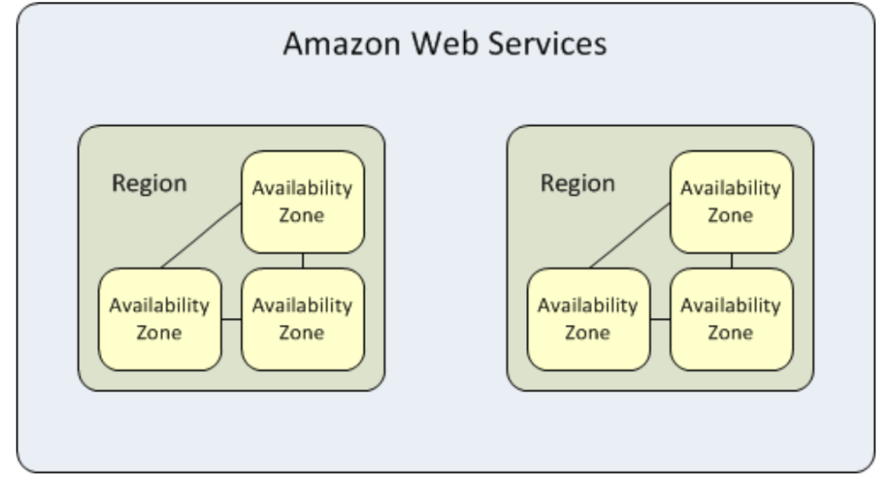
AWS AVAILABILTY ZONES

Slide 12
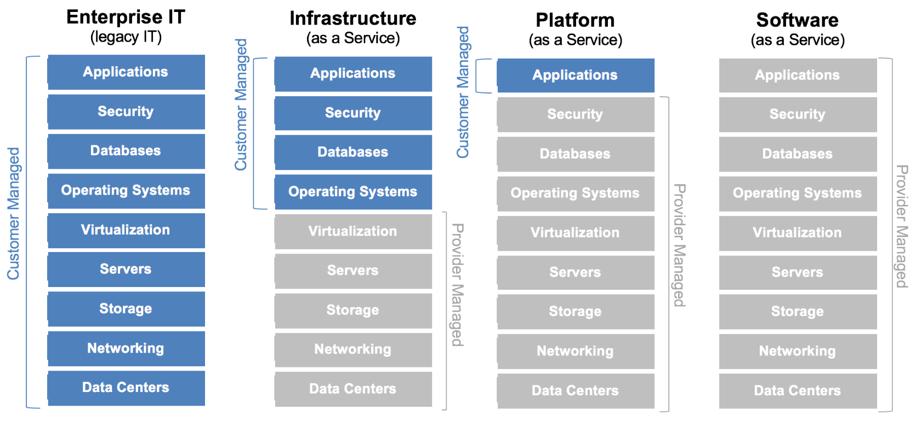
AWS Application STACK

Slide 13
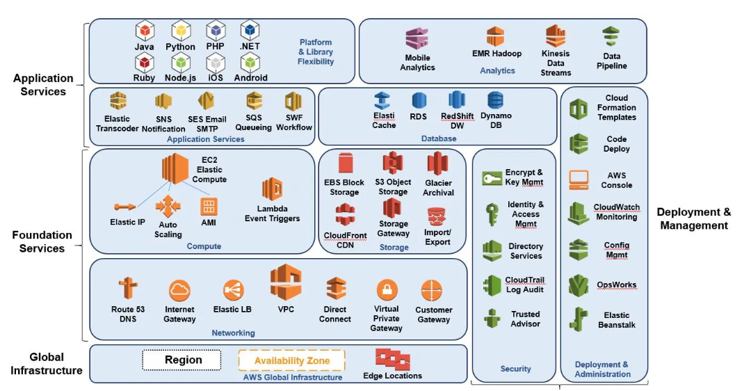
AWS Application STACK

Slide 14
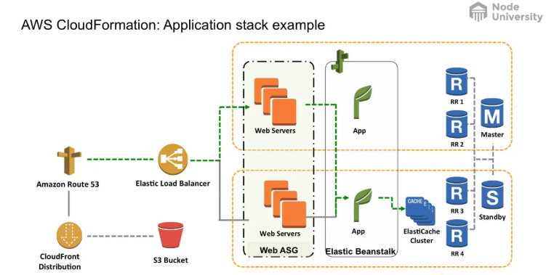
AWS Application
possible solution

Slide 15
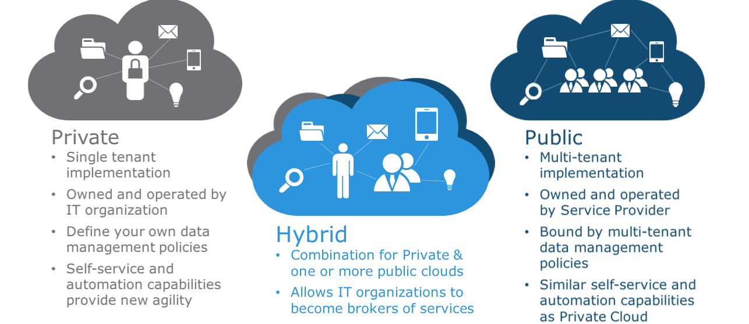
TYPES OF cloud
architecture

